Slide 1
Social and Emotional Learning, Academic Achievement, and Inequality
SEL’s potential to improve academic outcomes: Expanding the evidence base
Julianne Norman
SEL Technical Advisor

Slide 2

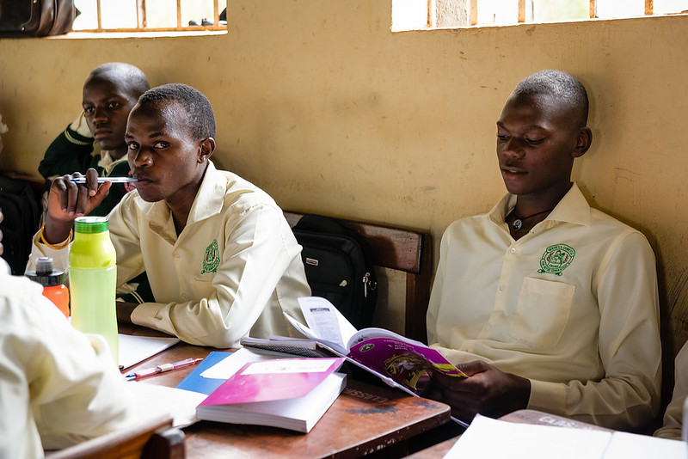
SEL’s potential to improve the learning crisis
Notes:
Programs based on the social and emotional learning (SEL) of children have unexplored potential to address the challenges of the global learning crisis, particularly inequalities in educational achievement and learning losses post-COVID-19. Previous research suggests that academic achievement is related to children’s social-emotional competencies—agency, growth mindsets, self-efficacy, and relationship skills—and to a supportive learning environment. However, more evidence is needed in order to attribute academic achievement to specific social-emotional competencies.

Slide 3
Assessments and Results: Kenya
Improvements in English oral reading fluency scores associated with demographic and SEL variables
Study 1: A National Survey of SEL in Grades 1-3 in Kenya
6,300 children selected randomly; nationally representative
SEL assessment with six subtest:
Assessor-rated confidence
Self-rated confidence
Relationships
Hostile attribution bias
Creativity
Perceived learning environment
Notes:
The first study was a national study of SEL and academic achievement in grades 1–3 in Kenya (Jukes et al., in prep). The study was part of the endline evaluation of Tusome (“Let’s Read” in Kiswahili), a project that reached seven million Kenyan children with the aim of improving literacy outcomes. The sample was selected randomly and designed to be nationally representative, with 6,300 children (10 in each grade and each school) from 210 schools in 26 of the 47 counties in Kenya.
The study included an SEL assessment with six sub-tests. These sub-tests mapped onto the two categories discussed above: children’s social-emotional competencies and learning environments.
In this study, we used a multiple regression model to analyze the relation between SEL measures and children’s oral reading fluency and reading comprehension in both English and Kiswahili. We found independent relations for all literacy outcomes with five of the SEL sub-tests: assessor-rated confidence, self-rated confidence, interpersonal negotiation strategies, number of friends, and supportive learning environment. In each case, one additional point on the SEL sub-scale was associated with a 1–2 percentage point increase in literacy scores. The strongest effects were for self-rated confidence and assessor-rated confidence.
Note that there was an independent relation between each of the SEL sub-tests and literacy scores. This means that there is a cumulative benefit from being strong in the five SEL sub-tests where significant associations were found. Thus, a child who is confident, is effective at interpersonal negotiation, has many friends, and benefits from a supportive learning environment in class will, on average, score 10–20 percentage points higher in all four literacy assessments. This analysis shows that academic achievement is associated with each of the elements of SEL that we identified in the introduction—children’s self-concept (self-confidence and observed confidence), children’s relationships skills and the number of relationships, and the quality of their learning environment.
The analysis also showed that girls benefitted more from a positive learning environment than boys. For each additional point on the 20-point learning environment scale, boys’ literacy scores improved by around 0.5 percentage points and girls’ scores by 1.5 percentage points. One possible explanation for this finding is that perceived social norms limit girls’ willingness to participate in class. A supportive learning environment may help counteract the effect of gendered social norms and thus have a greater impact on girls’ participation in class than boys’.
An analysis of associations between demographic variables and the SEL sub-scales found an advantage to being from a wealthy family and, for some sub-tests, living in an urban area (see Table 2). All but one of the SEL sub-tests in the Kenya study were positively associated with family wealth. Children in urban areas were also more confident, were more creative, and had more friends, but perceived their learning environment to be less supportive. Girls were more confident than boys, were less likely to assume hostile intent, and perceived their learning environment to be more supportive.
There were similar inequalities in literacy outcomes. The bars in Figure 2 show the association between English oral reading fluency scores and demographic variables. The height of the bar represents the difference in oral reading scores between the two demographic groups. Children in urban areas read in English at around 7 words per minute faster than those in rural areas; children in the middle third of household wealth read at around 7 words per minute faster than those in the poorest third; and children in the wealthiest third of households read at around 5 words per minute faster than those in the poorest third.
So far, our analyses show that urban, wealthy children are advantaged in both SEL and literacy and that SEL is a strong predictor of literacy. We also investigated whether the advantage of urban, wealthy children in literacy can be attributed to their advantage in SEL. In a statistical model controlling for SEL scores, we found that the association of urban residence and wealth with literacy scores was significantly reduced. The dark blue portion of the bars in Figure 2 show the association between literacy and these demographic variables when controlling for SEL scores. The figure shows that about 40% of the urban advantage in literacy may be attributed to the advanced social-emotional competencies of urban children. This finding suggests that if the social-emotional competencies and learning environments of children in rural areas were similar to those in urban areas, the rural disadvantage in academic achievement would be reduced by half. There is a similar figure – around a 40% reduction - for inequalities between the middle and lower third of the wealth distribution. That is, around 40% of the advantage in literacy of wealthy children is attributable to their social-emotional competencies; if the social-emotional competencies and learning environments of children in the poorest third of households were similar to those in the middle third, the inequalities in academic achievement would be reduced by 40%. Counterintuitively, the top third in the wealth distribution has a smaller advantage over the bottom third in reading fluency than the middle third. The reduction in this inequality when controlling for SEL scores is also smaller.
A final finding of this study was the learning environments were more important for girls’ academic achievement than for boys’ achievement. An increase in one point in the learning environment score – on a scale of 0-20 – was associated with an increase of 0.3 words per minute in English oral reading fluency for boys and 1.2 words per minute for girls. This finding suggests that girls benefit more academically than boys from a positive emotional climate in class.

Slide 4
Assessment and Results: Ethiopia
Study 2: The Relationship between Agency and Academic Achievement in Young Lives Data
Longitudinal research project following 12,000 children in Ethiopia, India, Peru, and Vietnam since 2002
Agency
If I try hard, I can improve my situation in life.
I like to make plans for my future studies and work.
If I study hard, I will be rewarded with a better job in the future
The longitudinal relationship between mathematics achievement and agency in Ethiopia
Notes:
The second study (Jukes & Hossain, in prep) involved an analysis of Young Lives data. Young Lives is a longitudinal research project that has followed a total of 12,000 children in Ethiopia, India, Peru, and Vietnam since 2002. There were two cohorts involved in the study. We analyzed data from the older cohort who were 8 years old at the start of the study and 22 years old in the fifth round of data collection in 2016—the last round included in our analysis. The study had excellent follow-up rates, with more than 91 percent of the original sample participating in the round-five data collection (Favara et al., 2021).
The socio-emotional competency of interest in this study was agency. Agency, as discussed in the introduction, belongs to a class of self-concept competencies, alongside self-confidence and self-efficacy. Agency is an individual’s ability to make purposeful choices (Samman & Santos, 2009). In our analysis, the agency scale consisted of three items. For each item, participants indicated their agreement with a statement on a Likert scale:
1. If I try hard, I can improve my situation in life.
2. I like to make plans for my future studies and work.
3. If I study hard, I will be rewarded with a better job in the future.
The study examined the relation between agency and mathematics. Mathematics achievement was assessed by one arithmetic question in the first round of data collection and subsequently by a test consisting of ten items selected from the Trends in International Mathematics and Science Study.
The longitudinal data were analyzed using a structural equation model for each country (Jukes & Hossain, in press). Structural equation models allow us to simultaneously examine the relation between several variables over time. Figure 3 shows the structural equation model with coefficient estimates for Ethiopia.
The largest coefficients in Figure 3 are between the mathematics achievement scores in each round. Mathematics achievement at age 12 is the strongest predictor of mathematics ability at age 15, which in turn is the strongest predictor of mathematics achievement at age 19. These strong relationships indicate that mathematics ability is relatively stable through adolescence. By contrast, the agency measure was less stable. There was no significant relationship between agency at age 12 and agency at age 15. The relationship between agency in subsequent rounds of data collection was significant but small. Interestingly, agency at each time point is significantly predicted by mathematics ability at the previous time point. In fact, agency at age 15 is more strongly predicted by mathematics at age 12 than by agency at age 12.
In conclusion, this data shows a bidirectional relationship between agency and academic achievement. We found that an individual’s level of agency varies throughout adolescence and that achieving academically can lead to a stronger sense of agency. Mathematics achievement is more stable through adolescence, but—at least in two countries—a strong sense of agency contributes to improved achievement.

Slide 5

Implications
Social-emotional competencies and learning environments are related to academic learning and may help explain inequalities in academic achievement.
Fine-tune understanding of SEL: identifying the relationship between specific SEL skills and academic achievement.
Learning climate matters
Notes:
The Young Lives and Kenya studies provide us with new evidence that suggests possible approaches to address the learning crisis, especially for learners most at risk. First, these studies suggest that social-emotional competencies and learning environments are related to academic learning and may help explain inequalities in academic achievement. This conclusion applies to several types of inequality—namely, those due to gender, wealth, and urban residence. The Tusome data from Kenya show that children from wealthy families are more advantaged in both SEL and literacy and that part of their advantage in literacy can be explained by their advantage in SEL. We saw similar findings for children in urban areas, whose academic advantage could also be explained in part by their stronger SEL skills. Both studies suggested ways to tackle gender inequalities. In the Kenya study, girls’ academic achievement was more sensitive than boys’ academic achievement to learning environment. Where there is gender inequality in education outcomes, improving the quality of supportive learning environments could help address these inequalities. Data from the Young Lives study show that girls increasingly lag behind boys in self-efficacy throughout adolescence. Self-efficacy—and related dimensions of self-concept such as agency—is instrumental for educational achievement and other life outcomes. Interventions aimed at improving girls’ agency and self-efficacy could help address inequalities in these outcomes.
Second, data from these studies help fine-tune our understanding of SEL by identifying the relationship between specific SEL skills and academic achievement. These skills include aspects of self-concept (self-confidence and agency), relationship skills, and interpersonal negotiation. It would be helpful for the design of SEL programs if future work could help identify more social-emotional competencies that can contribute to improved academic performance.
The third takeaway from the studies presented in this paper is that learning climate matters. We found direct evidence for this in the study from Kenya. The academic achievement of children was higher in more positive learning environments. As discussed above, this effect was stronger for boys than girls. Other findings may provide indirect evidence of the effect of positive learning environments. In theory, positive learning environments lead to improved relationships and interpersonal skills, and we found that children who were strong in these areas had better academic achievement. These findings imply that if education systems focused on establishing positive and supportive learning environments, there might be potential for academic learning to improve. As discussed in the introduction, this potential may be greater in contexts where the norm is for students to be passive recipients, rather than active participants, in their learning. In addition, learning climate and SEL may be mutually reinforcing. When certain conditions for learning are met—students feel cared for and appreciated; they are physically and emotionally safe; diversity is valued—SEL develops (Randolph et al., 2019). And as students’ social-emotional aptitude grows, this influences the dynamics of the classroom and influences the learning climate (teachers have a role to play in this as well).
A final set of conclusions from these studies relates to our understanding of the importance of context in understanding how social-emotional competencies can help children achieve at school.

